Slide 1
D2D Advanced Tableau Training
April 23rd and April 25th
presented by Walter Mehra
D2D Team Member

Slide 2
Pre-Class Activities
Please make sure you do the following prior to the training session:
Ensure that Tableau Desktop (version 10) or higher (D2D is on 10.4.1) is installed on your computer and you have a valid license (or are on Tableau granted two-week trial license);
Download the dataset used for this training to your computer’s desktop

Slide 3

Objectives
Analysis on the City Pairs Program (2018 Data)
LOD Calculation
Z-Scores
Pearson Correlation Coefficient (CORR)
Regression Analytics
Clustering Analytics

Slide 4
Data Terminology
Data Type | Descriptions/Details | Examples
Number (Decimal) or Number (Whole) | These are either integers or floating points. If a variable can take on any value between two specified values, it is called a continuous variable; otherwise, it is called a discrete variable | 3 or 3.14159265359 (Continuous)
Date or Date and Time | Tableau recognizes dates in almost all formats, these values are typically used for time series or trend analysis | 11/28/2017 or 11/28/2017 1:00 PM
Boolean | They are logical values | True or False
String | Any sequence of characters. They are enclosed within single quotes. The quote itself can be included in a string by writing it twice. | GSA, Budget Activity, Lease, NAICS
Geographic Role | Not a datatype, but does clarify the desired outcome for the data field Identifier for Tableau to facilitate map building included roles are Airport, Area Code, CBSA/MSA, City, Congressional District, Country / Region, County, Latitude, Longitude, NUTS Europe, State/Province, Zip Code/Postcode | KIAD (Airport), 202 (Area Code), VA (State/Province), etc.
Tableau will categorize your data fields into one of two buckets:
Dimension is something you categorize with (e.g., color of a shirt)
Measure is something you do math with (e.g., the number of white shirts)

Slide 5
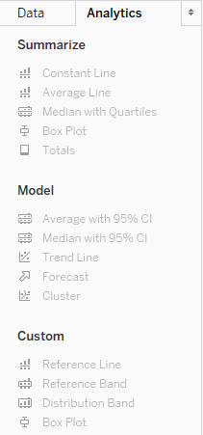
Advanced Analytics Pane
Model
Average w/ 95% CI
Median w/ 95% CI
Trend Line: Build a linear regression model
Forecast: Quantitative time-series data using exponential smoothing models in Tableau Desktop. These models capture the evolving trend or seasonality of your data and extrapolate them into the future.
Cluster: Using k-means, partition the data into k [number of] clusters using the cluster mean. Tableau automates the creation of clusters, including the number of clusters created; clustering aggregates data into groups that are most similar to each other vs. the other groups

Slide 6
Level of Detail Analysis (Advanced Analytics)
Dataset(s): Sample - Superstore
Steps:
Create a new sheet, call it LOD
Create two new Calculated Fields:
First Purchase Date: {FIXED [Customer Name] : MIN([Order Date])}
Days Since First Purchase: DATETRUNC('day', [Order Date])-DATETRUNC('day', [First Purchase Date])
Convert Days Since First Purchase to a Dimension
Drag Days Since First Purchase to the Columns shelf and convert it to a Continuous field
Drag Sales to the Rows shelf
Change the aggregation for Sales on Rows from SUM to AVG
Add a quick table calculation to Sales on Rows: Running Total
Drag First Purchase Date to Color.
Click the + in the YEAR(First Purchase Date) field on Color to add the next level down in the date hierarchy: QUARTER(First Purchase Date).
Change the QUARTER(First Purchase Date) to affect the viz Color
Just like basic calculations, LOD calculations allow you to compute values at the data source level and the visualization level. However, LOD calculations give you even more control on the level of granularity you want to compute. They can be performed at a more granular level (INCLUDE), a less granular level (EXCLUDE), or an entirely independent level (FIXED) with respect to the granularity of the visualization.
LOD Expressions can be set to:
FIXED (not impacted by the dimensions in the Viz)
INCLUDE (includes dimensions within expression AND in the Viz)
EXCLUDE (exclude dimensions in the Viz from the calculation)
Tableau Resource on LOD Expressions

Slide 7

Z-Score Analysis (Analytics)
Dataset(s): FY18 - CPP Award Data
Question: Can we quantify the difference of the unrestricted fare relative to the population set?
Steps:
Open Tableau
In the Connect pane, select More
Browse to the FY18 – CPPAwardData Tableau Extract file
Create a new sheet, title it Z-Score Viz
Create new Calculated Fields:
AVG UNR FARE: WINDOW_AVG(avg([Unrestricted Fare (YCA)]))
STDEV UNR FARE: WINDOW_STDEV(avg([Unrestricted Fare (YCA)]))
Z-Score: (avg([Unrestricted Fare (YCA)]) - [AVG UNR Fare]) / [STDEVP UNR Fare]
Drag Origin City Name to the Rows shelf
Drag Z-Score to the Columns shelf
Sort the data in descending order
Calculate the Z-Score for Destination City Name
Question – What are the interesting values? What is driving the Z-Score?
Z-Score enables us to standardize the data and compare it among datasets
It’s a calculation that enables you to quantify how many standard deviations from the mean the data is
Roughly 95% of the data should have a Z-Score between -2.0 and +2.0

Slide 8

Correlation Analysis (Advanced Analytics)
Dataset(s): FY18 - CPP Award Data
Question: Do Passenger Counts Affect Unrestricted Fares?
Steps:
Create a new sheet, call it Correlation Analysis
Create a new Calculated Field, name it CORR Fare:Passenger
CORR([Passenger Count (PAX)],[Unrestricted Fare (YCA)])
Drag Origin City Name and Origin State to the Rows shelf
Drag CORR Fare:Passenger to the Text marks card, then drag it to the filter (select Special and Non-null values) and Show Filter
Question – What does the data tell us?
Create a new sheet, call if Correlation Viz
Drag Passenger Count to the Columns shelf
Drag Unrestricted Fare to the Rows shelf
Select Analysis from the menu and uncheck Aggregate Measures
Drag City Pair to the Labels marks card
Bring in the filters from our first sheet
Review the data by selecting a positive correlation coefficient and a negative correlation coefficient
Identify linear relationship between a sample set of data for two variables (theoretically can include more variables but not in Tableau)
Tableau includes Pearson Product-Moment Correlation Coefficient (or Pearson Correlation Coefficient)
Coefficient value ranges from -1.0 to 1.0
A value of 0 indicates that there is no association between the two variables.
A value greater than 0 indicates a positive association; that is, as the value of one variable increases, so does the value of the other variable.
A value less than 0 indicates a negative association; that is, as the value of one variable increases, the value of the other variable decreases.

Slide 9

End of Part 1
Any questions?
Anything you’d like covered for next time?
Notes:
Image Source: http://www.gsa.gov/portal/category/100000. Visited 12/7/15.

Slide 10
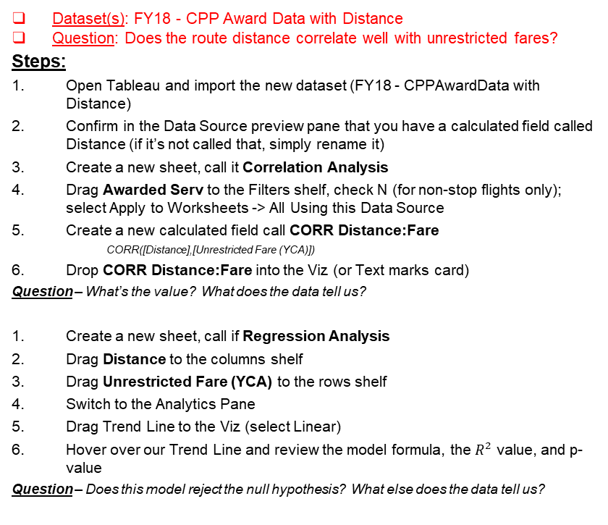
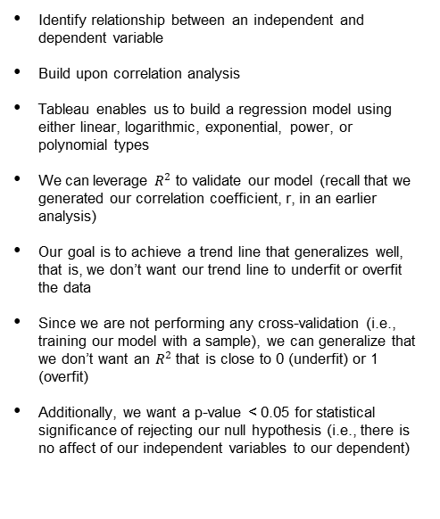
Linear Regression (Advanced Analytics)
Dataset(s): FY18 - CPP Award Data with Distance
Question: Does the route distance correlate well with unrestricted fares?
Steps:
Open Tableau and import the new dataset (FY18 - CPPAwardData with Distance)
Confirm in the Data Source preview pane that you have a calculated field called Distance (if it’s not called that, simply rename it)
Create a new sheet, call it Correlation Analysis
Drag Awarded Serv to the Filters shelf, check N (for non-stop flights only); select Apply to Worksheets -> All Using this Data Source
Create a new calculated field call CORR Distance:Fare
CORR([Distance],[Unrestricted Fare (YCA)])
Drop CORR Distance:Fare into the Viz (or Text marks card)
Question – What’s the value? What does the data tell us?
Create a new sheet, call if Regression Analysis
Drag Distance to the columns shelf
Drag Unrestricted Fare (YCA) to the rows shelf
Switch to the Analytics Pane
Drag Trend Line to the Viz (select Linear)
Hover over our Trend Line and review the model formula, the $R^{2}$ value, and p-value
Question – Does this model reject the null hypothesis? What else does the data tell us?
Identify relationship between an independent and dependent variable
Build upon correlation analysis
Tableau enables us to build a regression model using either linear, logarithmic, exponential, power, or polynomial types
We can leverage $R^{2}$ to validate our model (recall that we generated our correlation coefficient, r, in an earlier analysis)
Our goal is to achieve a trend line that generalizes well, that is, we don’t want our trend line to underfit or overfit the data
Since we are not performing any cross-validation (i.e., training our model with a sample), we can generalize that we don’t want an $R^{2}$ that is close to 0 (underfit) or 1 (overfit)
Additionally, we want a p-value < 0.05 for statistical significance of rejecting our null hypothesis (i.e., there is no affect of our independent variables to our dependent)

Slide 11
K-Means (Advanced Analytics)
Dataset(s): FY18 - CPP Award Data with Distance
Question: Can we segment routes based on distance?
Steps:
Create a new sheet, call it Cohort Analysis
Drag City Pair to the Rows shelf
Drag Distance to the Text marks card
Switch to the Analytics Pane and drag Cluster to the viz
Sort the data descending (by Distance)
Drag Cluster from the Color marks card into the Data Pane
Click on the Cluster in the Color marks card and select Describe Clusters
Question – How many clusters did Tableau calculate for this analysis? Any idea why?
Cluster analysis partitions marks in the view into clusters, where the marks within each cluster are more similar to one another than they are to marks in other clusters
Tableau uses the k-means algorithm for clustering (vs. other methods such as hierarchal, density, etc.)
The general steps for k-means are:
Randomly select cluster centers
Assign each instance to the nearest center
Recalculate the new cluster centers
Reassign each instance to the new closest cluster center
The process stops either when no instances are reassigned to a different cluster or when the specified number of maximum iterations is reached.

Slide 12
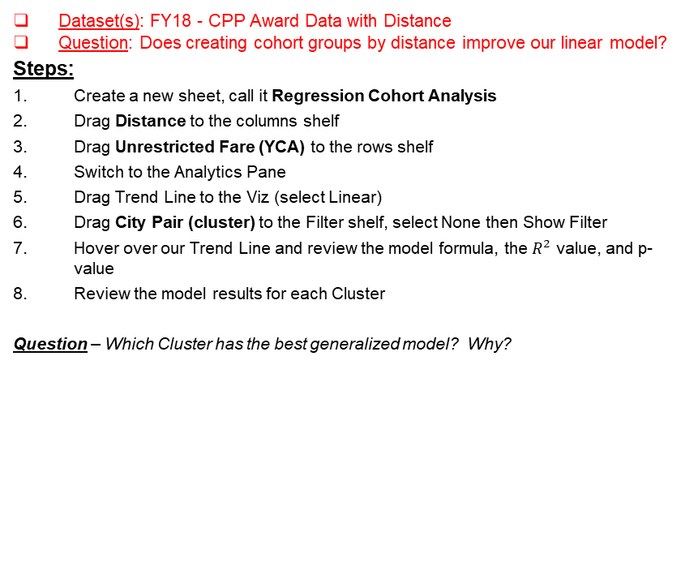
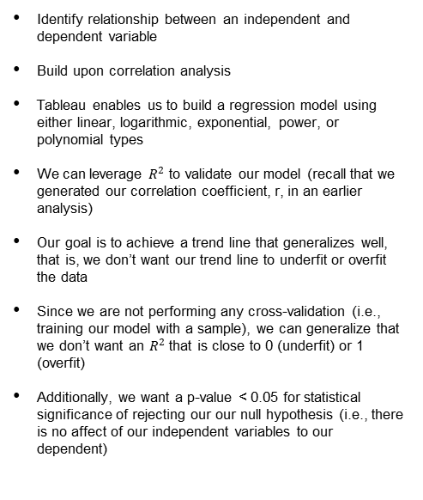
Linear Regression (Advanced Analytics)
Dataset(s): FY18 - CPP Award Data with Distance
Question: Does creating cohort groups by distance improve our linear model?
Steps:
Create a new sheet, call it Regression Cohort Analysis
Drag Distance to the columns shelf
Drag Unrestricted Fare (YCA) to the rows shelf
Switch to the Analytics Pane
Drag Trend Line to the Viz (select Linear)
Drag City Pair (cluster) to the Filter shelf, select None then Show Filter
Hover over our Trend Line and review the model formula, the $R^{2}$ value, and p-value
Review the model results for each Cluster
Question – Which Cluster has the best generalized model? Why?
Identify relationship between an independent and dependent variable
Build upon correlation analysis
Tableau enables us to build a regression model using either linear, logarithmic, exponential, power, or polynomial types
We can leverage $R^{2}$ to validate our model (recall that we generated our correlation coefficient, r, in an earlier analysis)
Our goal is to achieve a trend line that generalizes well, that is, we don’t want our trend line to underfit or overfit the data
Since we are not performing any cross-validation (i.e., training our model with a sample), we can generalize that we don’t want an $R^{2}$ that is close to 0 (underfit) or 1 (overfit)
Additionally, we want a p-value < 0.05 for statistical significance of rejecting our our null hypothesis (i.e., there is no affect of our independent variables to our dependent)

Slide 13
Outside Tableau Resources*
Official Tableau Resources
Online Help: http://onlinehelp.tableau.com/v9.0/pro/online/windows/en-us/help.htm
Quick Start Guide: http://onlinehelp.tableau.com/v9.0/pro/online/windows/en-us/help.htm
Training, videos, webinars, whitepapers, events: http://www.tableau.com/learn
Tableau User Groups -- these exist across the country. For example, here is the one for Washington, DC: http://community.tableau.com/groups/washington-dc
Tableau Public Gallery, lots of interesting-looking examples: https://public.tableau.com/s/gallery
Whitepaper “Designing Efficient Workbooks.” http://www.tableau.com/learn/whitepapers/designing-efficient-workbooks
Unofficial Tableau-related Sites
http://www.dataplusscience.com/TableauReferenceGuide/
http://vizpainter.com/
http://drawingwithnumbers.artisart.org/
https://3danim8.wordpress.com/

Slide 14


